Slide 1
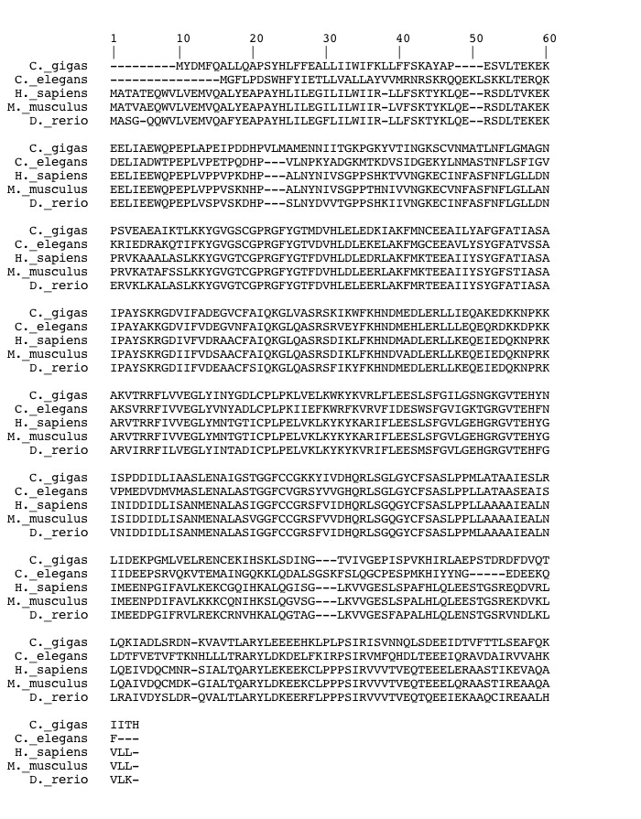
Notes:
Sptlc
Transmembrane domain: 21-41 (box)
Asparagine at 315 (arrow)

Slide 2
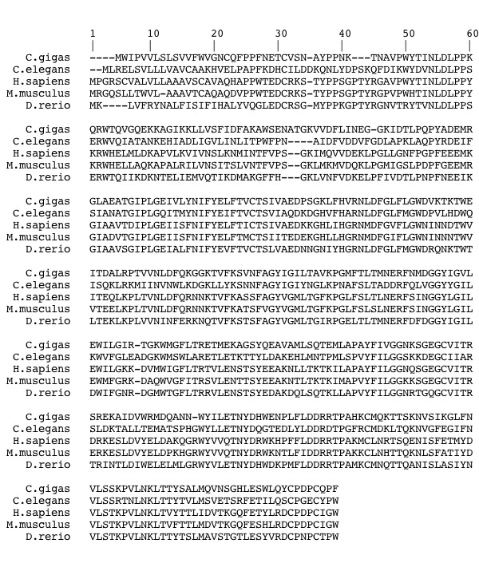
Notes:
AC
H. Sapiens transmembrane domain 5-25

Slide 3
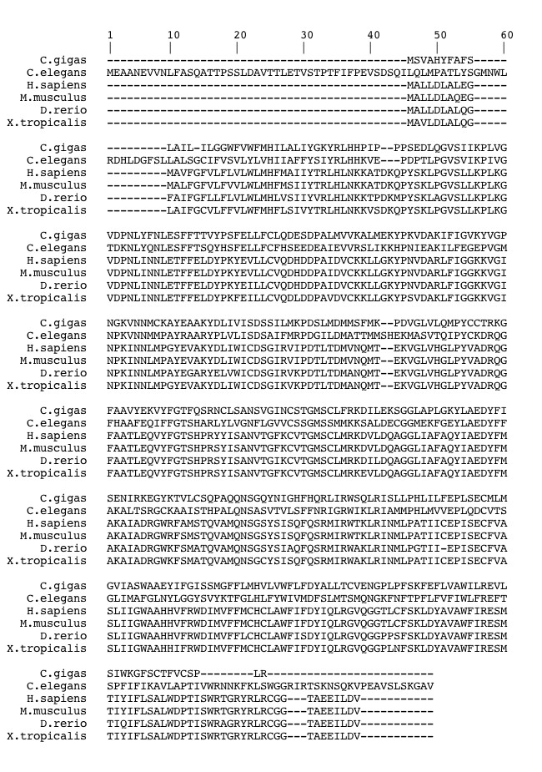
Notes:
CgT
H. Sapiens transmembrane domain 70-90
C.Gigas trans dom 48-90, 348-368, 377-397

Slide 4
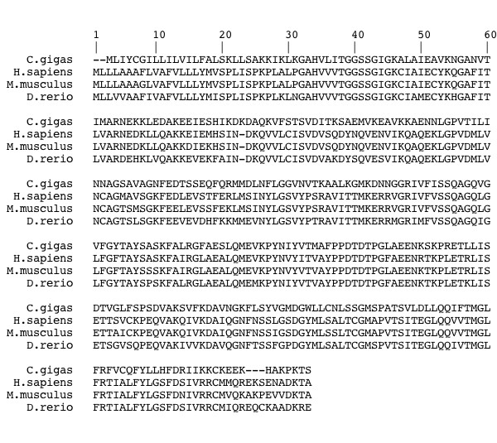
*
⬥
Notes:
3KDSR
Transmembrane 3-23
Tyr-Ser-X-Ser-Lys (diamond)
Gly-Gly-Ser-Ser-Gly-Ile-Gly (*)

